Slide 1


IDQ Probabilistic Models

Slide 12
Task 1 : Create Physical Data Object ➔ estore_sales

Slide 13
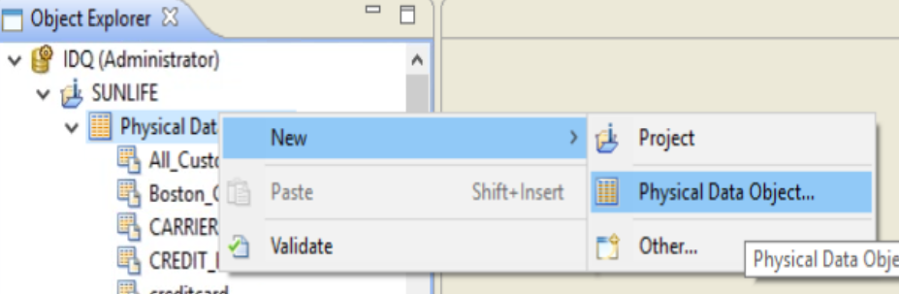
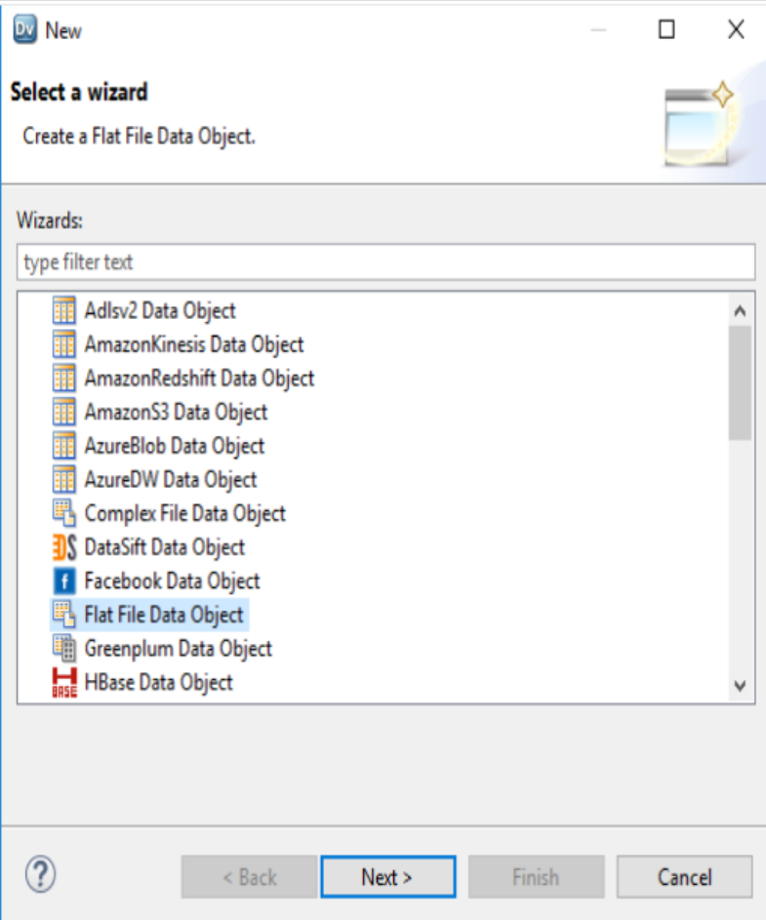
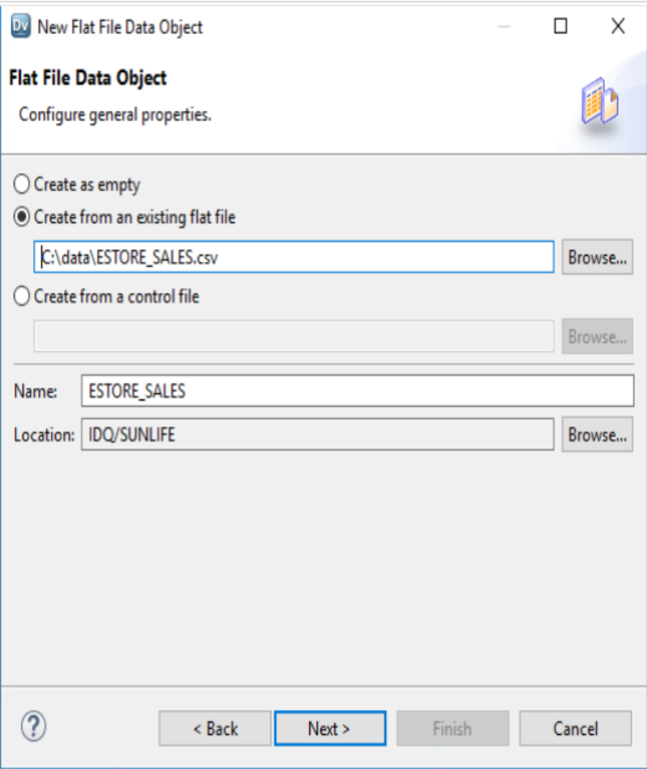
Step 1 : Create New Physical Data Objects
Name : estore_sales.CSV Delimited = Comma First Line Column Name => True Text Qualifier ➔ Double Quotes

Slide 14
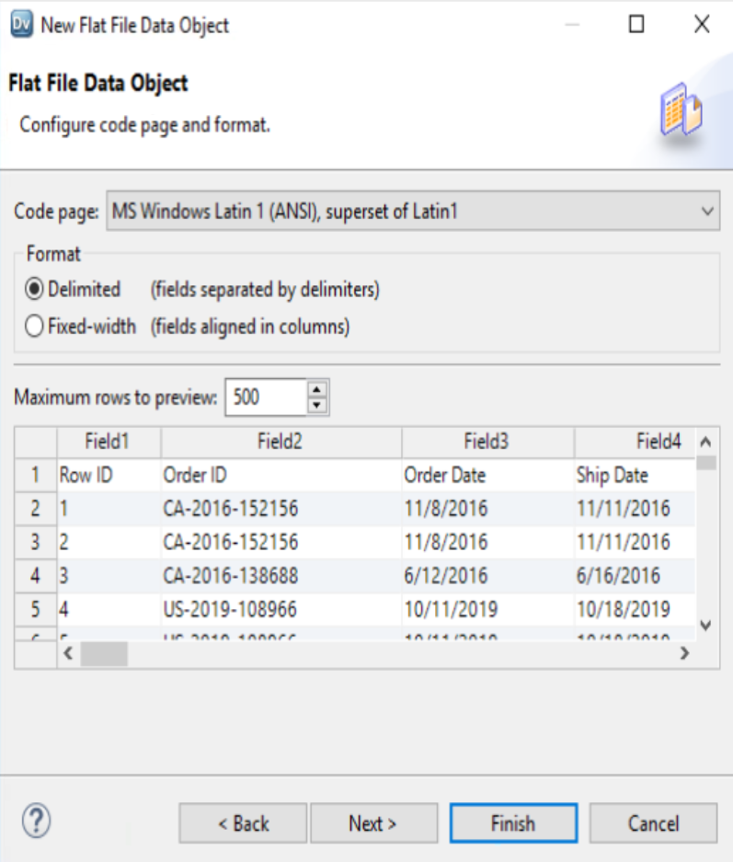
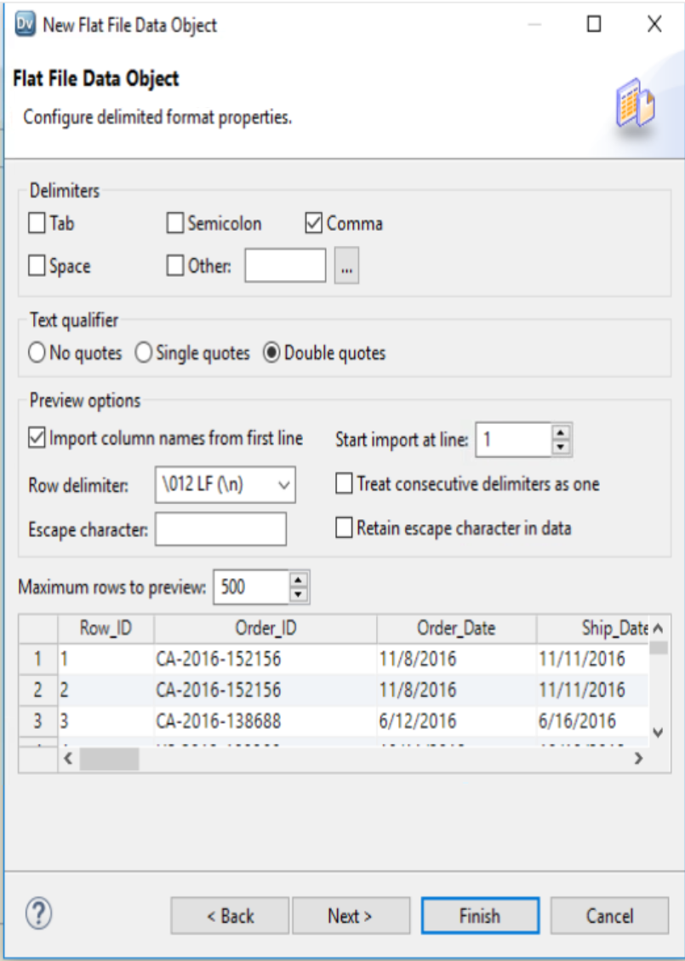
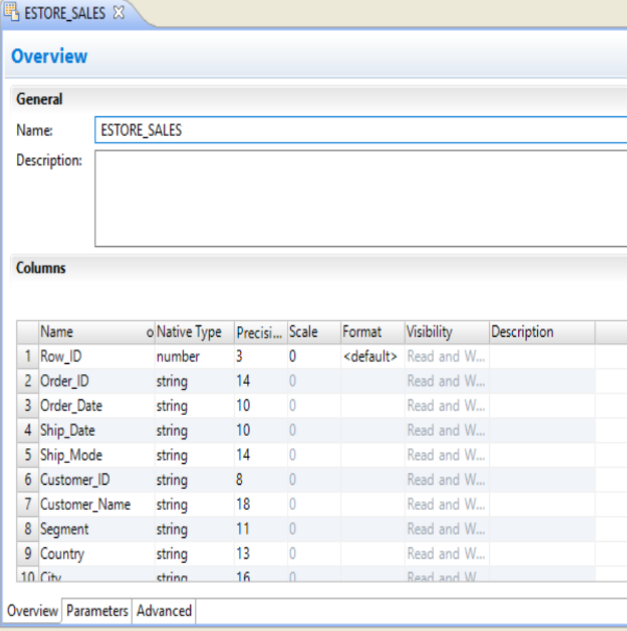
Step 1 : Create New Physical Data Objects
Name : estore_sales.CSV Delimited = Comma First Line Column Name => True Text Qualifier ➔ Double Quotes

Slide 15
Task 1 : Create Physical Data Object ➔ LABELDATA ➔ EMPTY ➔ ADD Columns

Slide 16
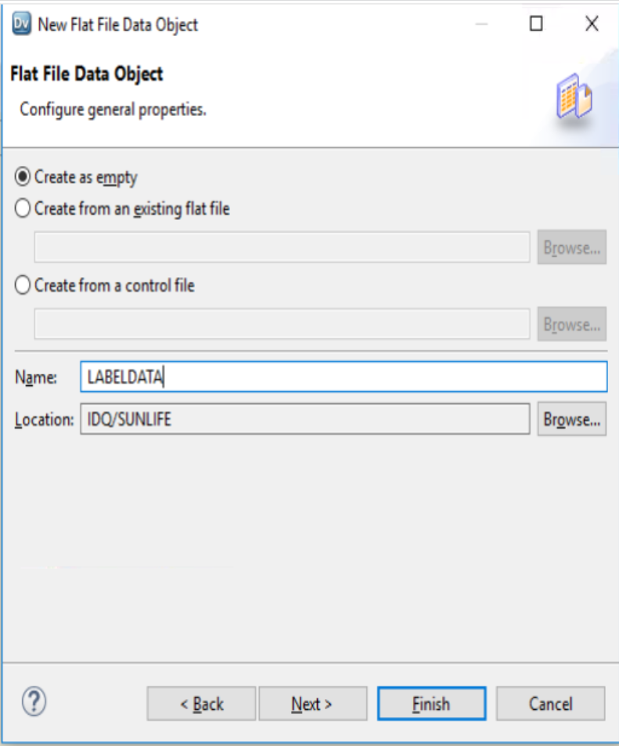
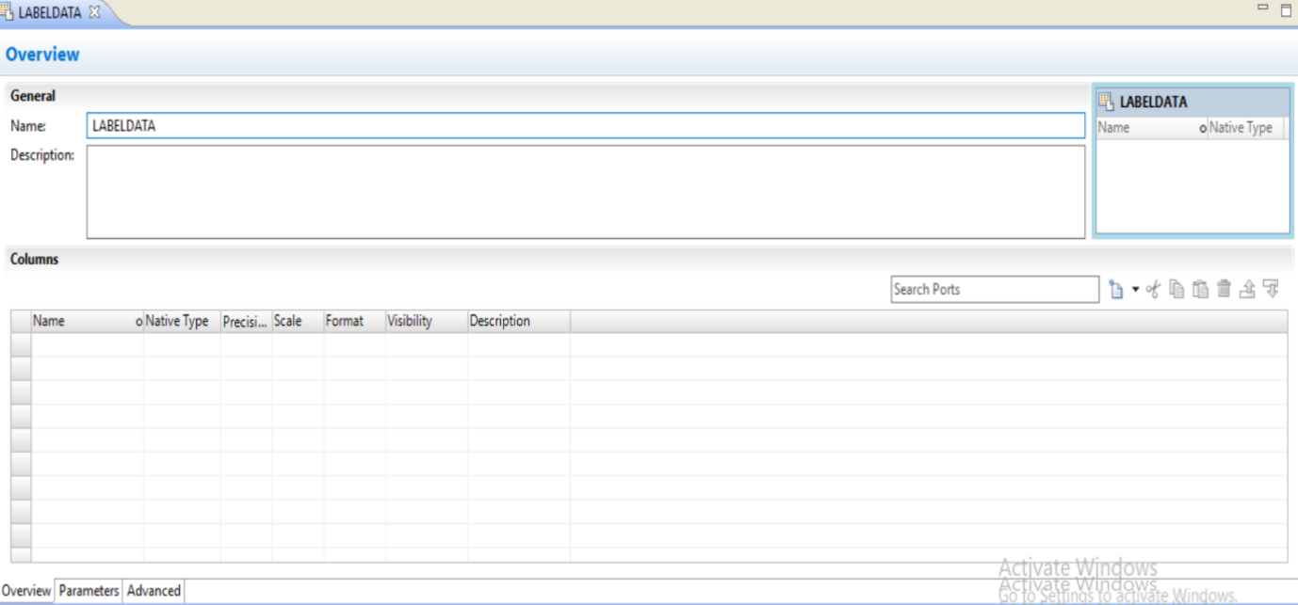
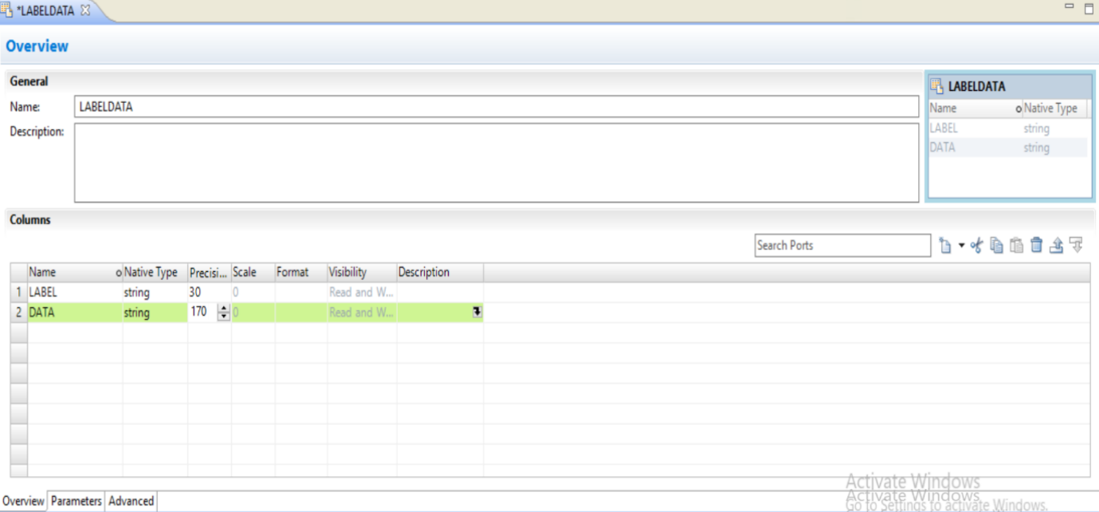
Step 1 : Create New Physical Data Objects
Name : LABELDATA.txt CREATE AS EMPTY
NEW COLUMN ➔ LABEL STRING➔ 30
DATA STRING 170

Slide 17
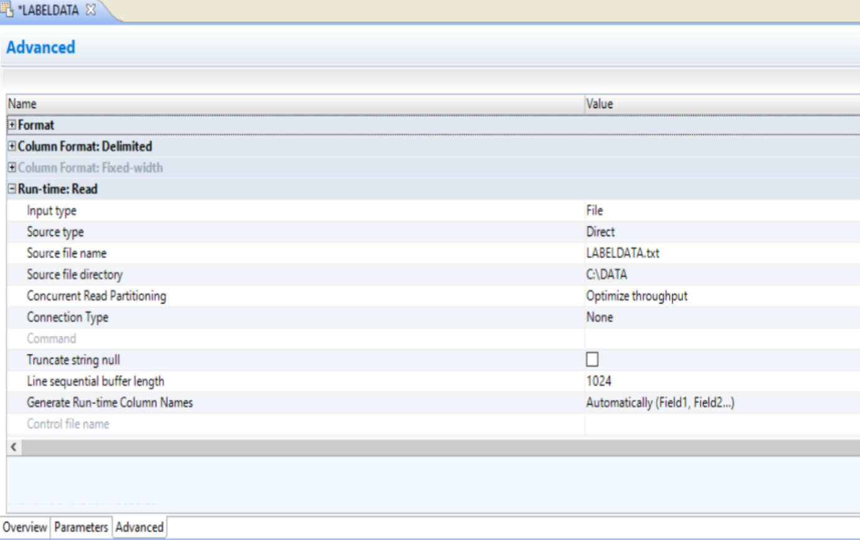
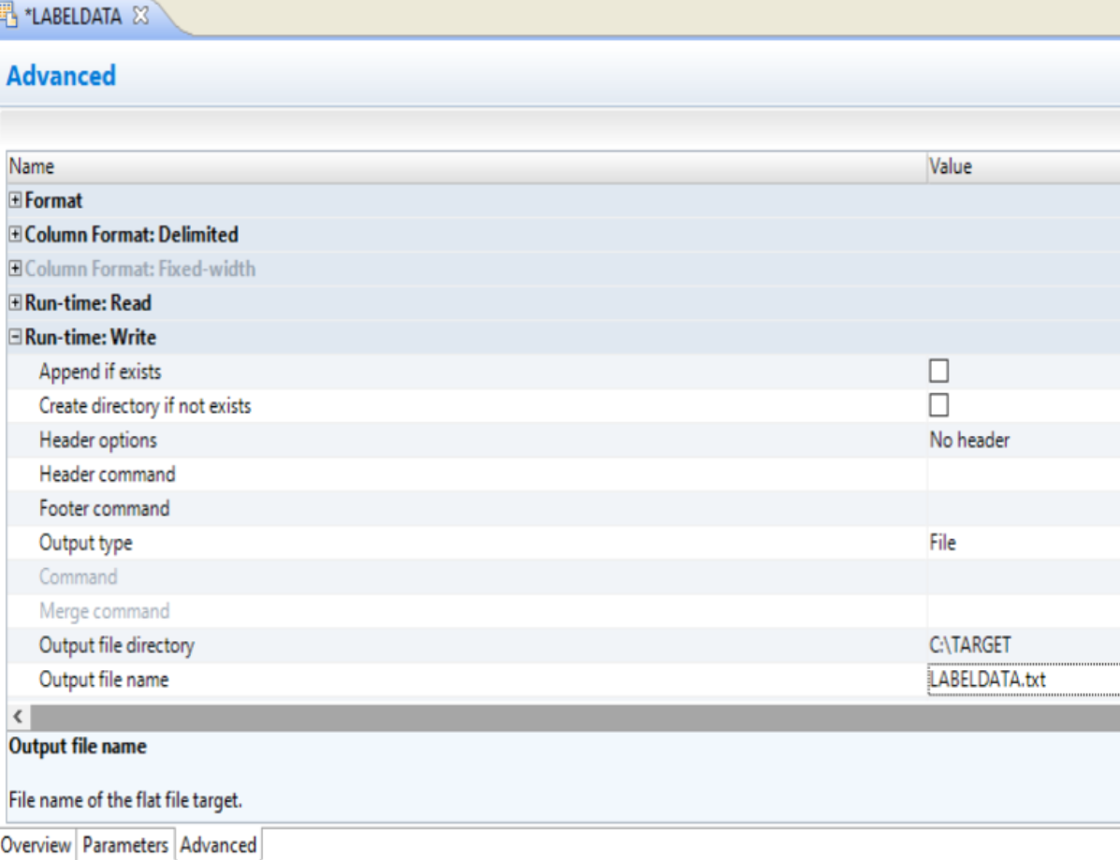
RUNTIME READ ➔ SOURCE ➔ C:\DATA ➔ FILENAME ➔ LABELDATA.txt
RUNTIME WRITE ➔ TARGETDIR ➔ C:\TARGET ➔ FILENAME ➔ LABELDATA.txt

Slide 18
Task 3 : DATA PROFILE ➔ estore_sales ➔ ANALYZE DATA

Slide 19
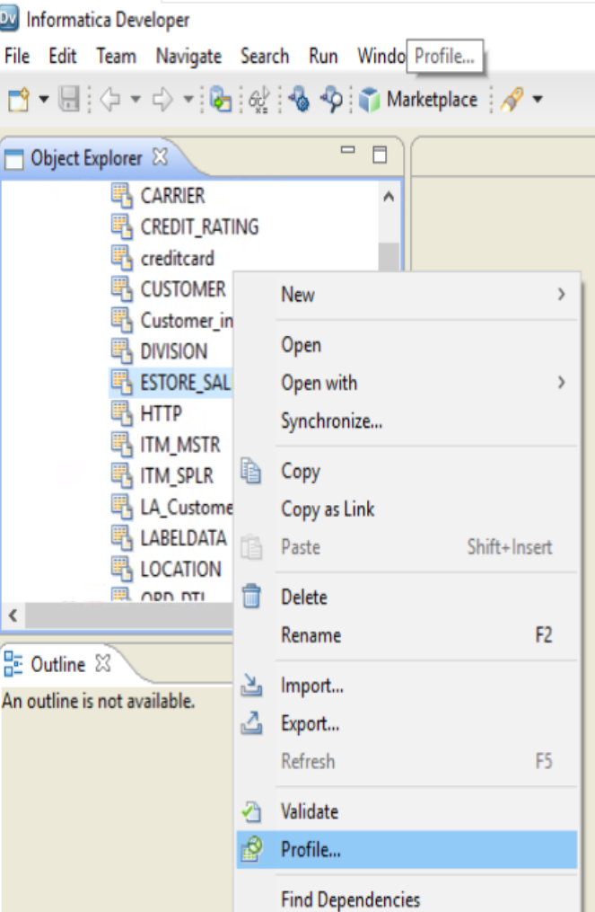
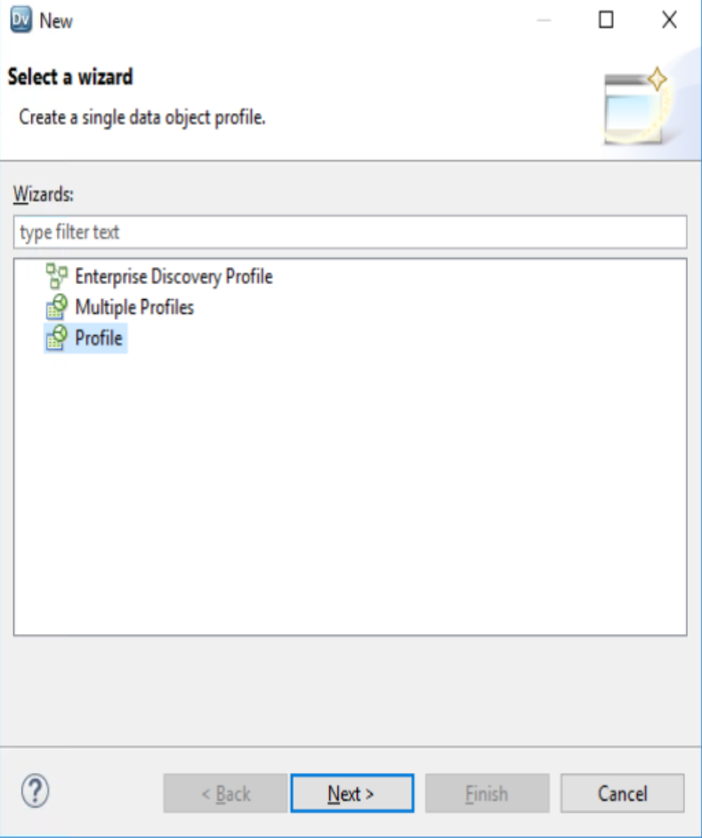
Data Profile ➔ ESTORE_SALES

Slide 20
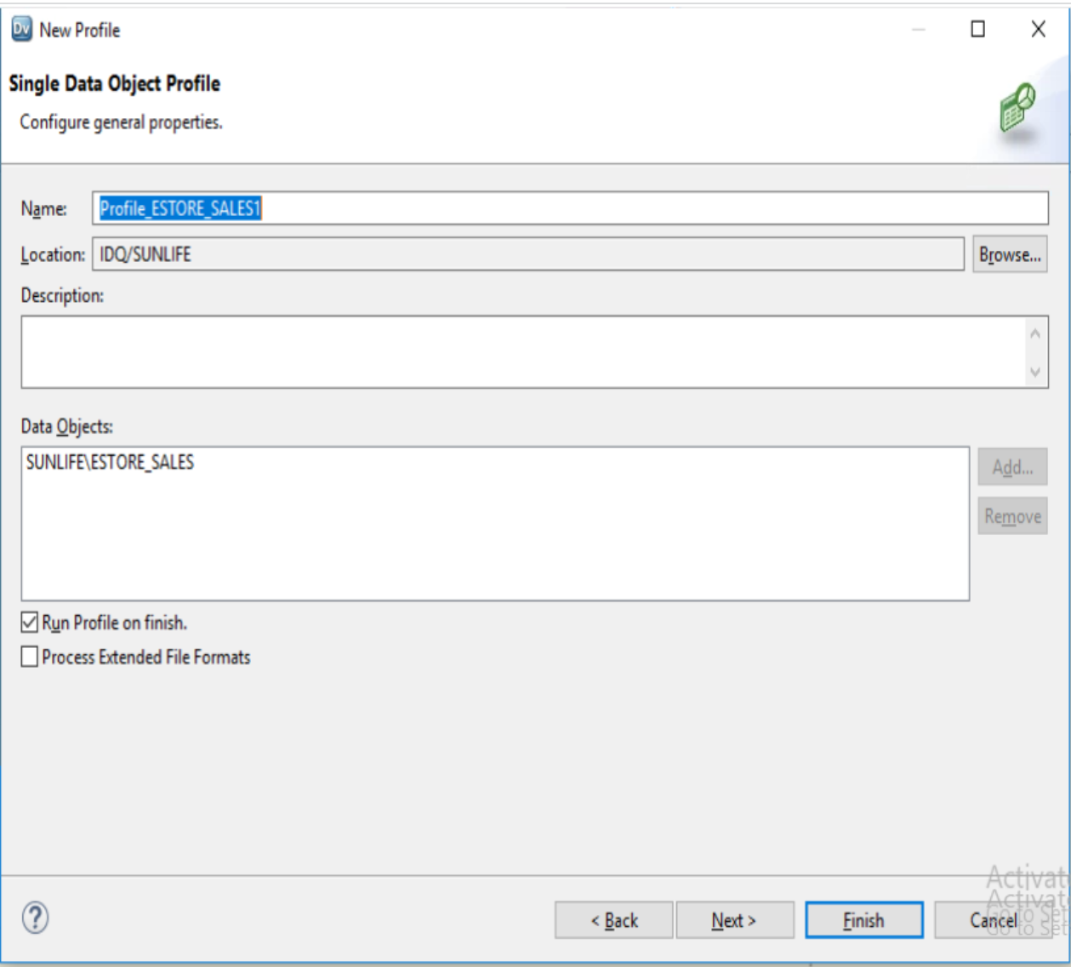
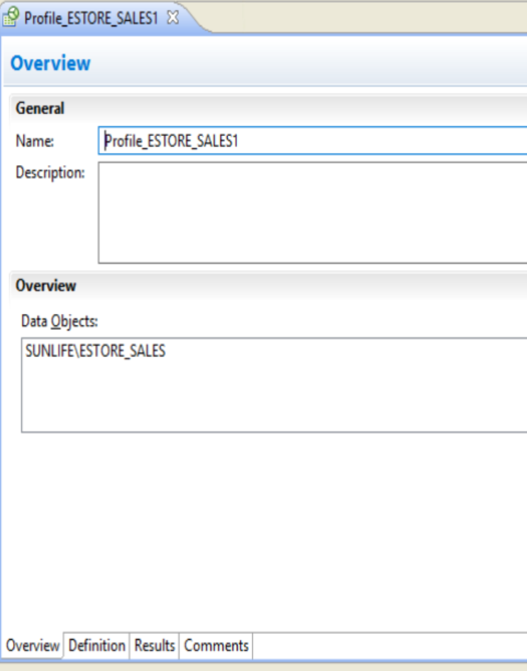
Data Profile ➔ ESTORE_SALES

Slide 21
Task 4 : From Data Profile ➔ estore_sales ➔ Create Reference Table ➔ Product_ID and BRAND

Slide 22
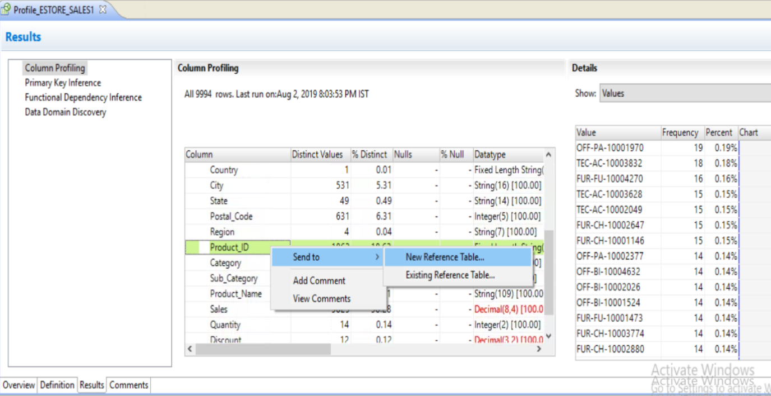
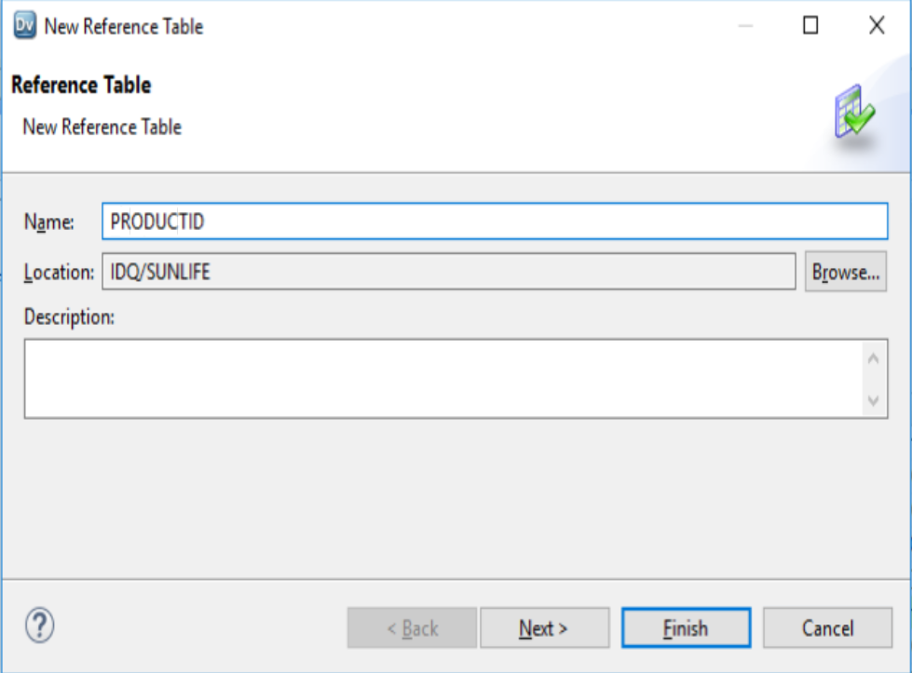
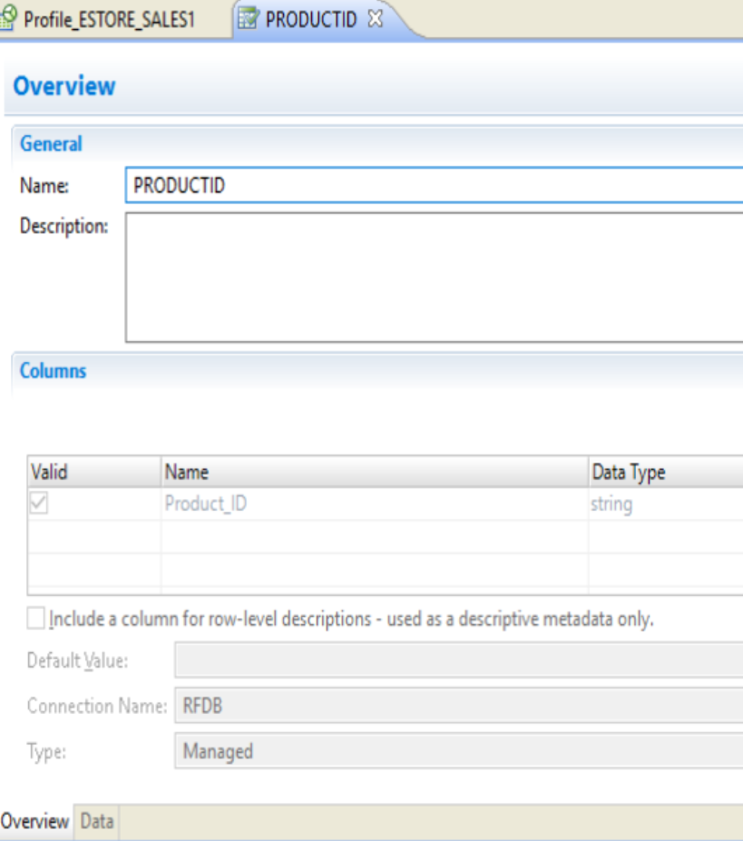
Choose PRODUCT_ID Column ➔ send to ➔ new reference table ➔ PRODUCTID ➔ Click on Finish

Slide 23
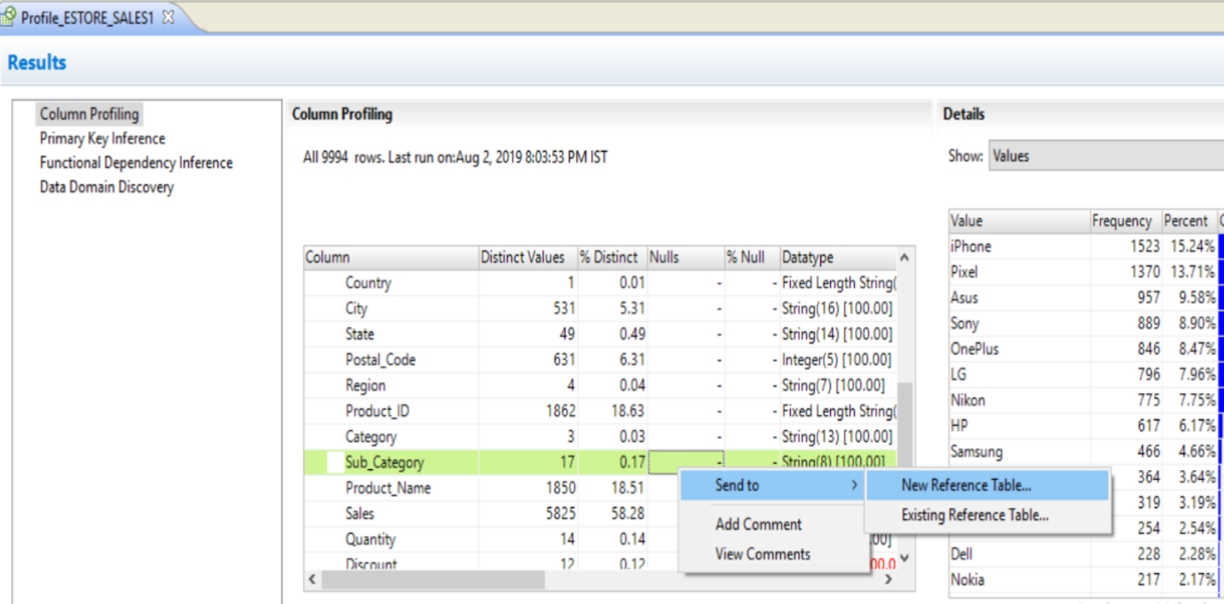
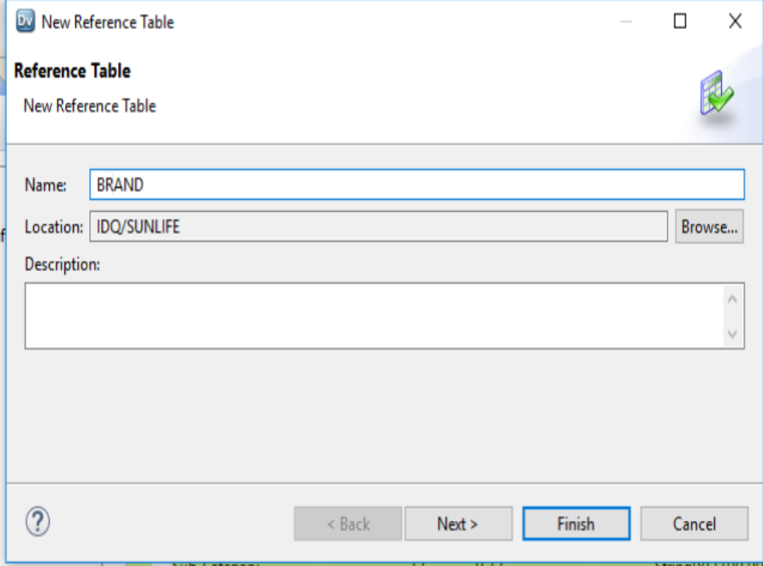
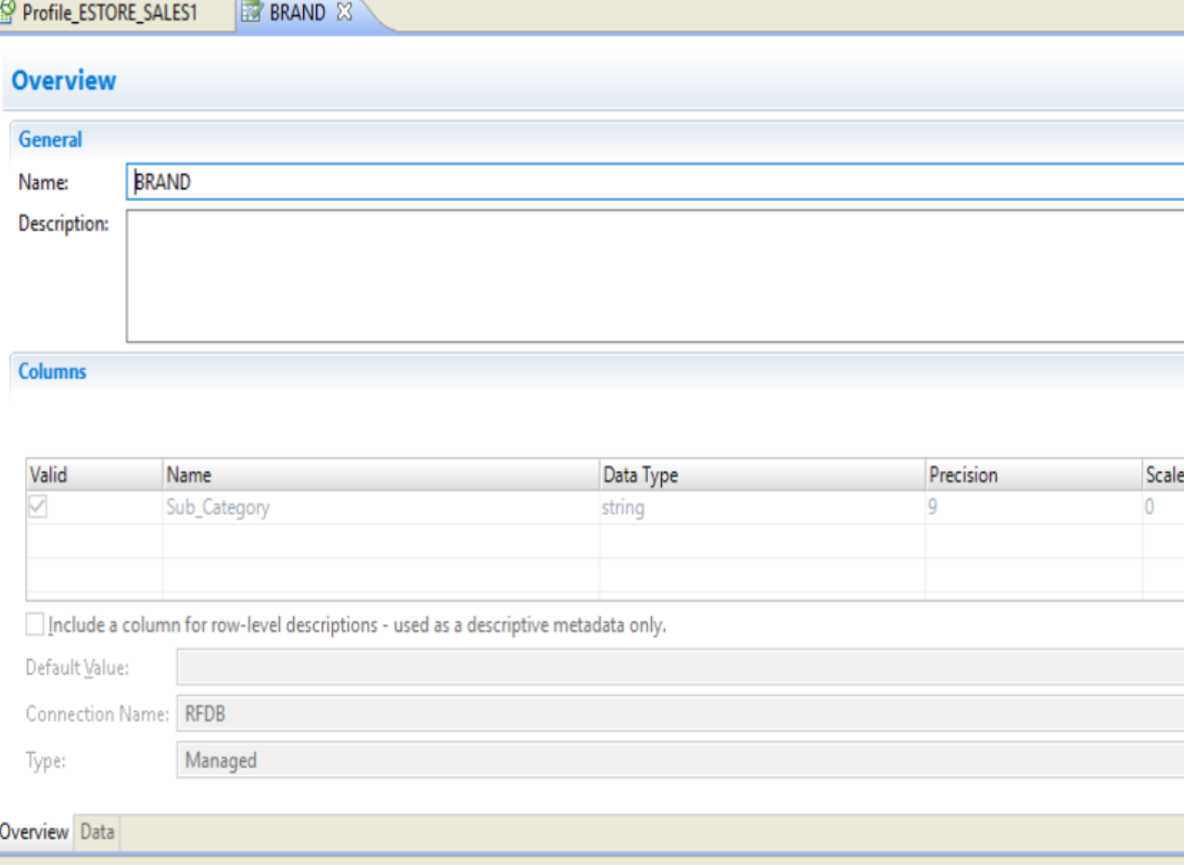
Choose SUB_CATEGORY Column ➔ send to ➔ new reference table ➔ BRAND ➔ Click on Finish

Slide 24
Task 4 : Create Mapping using Labeler to create pattern and Data

Slide 25
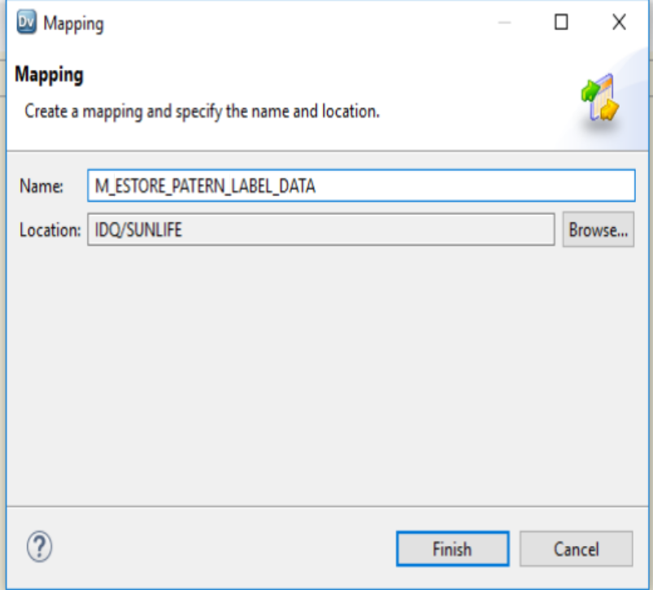
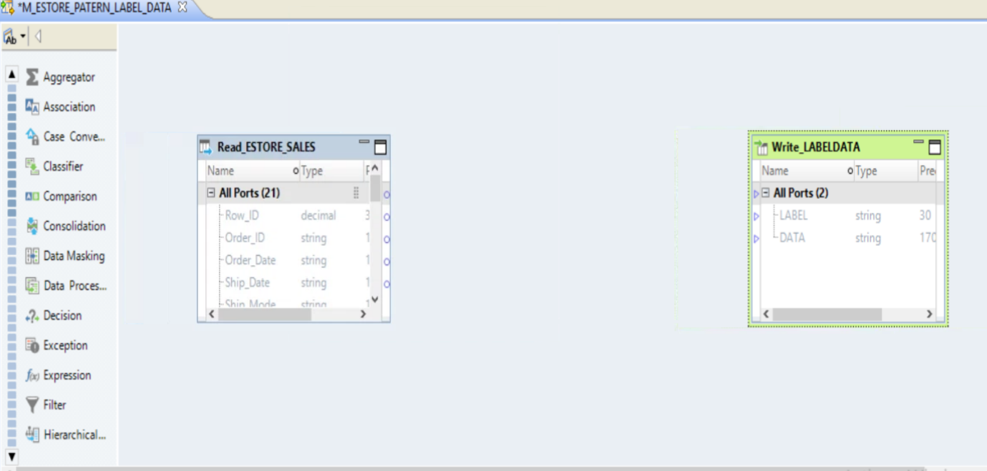
New Mapping ➔ NAME ➔ E_ESTORE_PATERN_LABEL_DATA
ADD READ (ESTORE_SALES) + WRITE ( LABELDATA)

Slide 26
Task 4b : ADD Filter Transformation and Condition

Slide 27
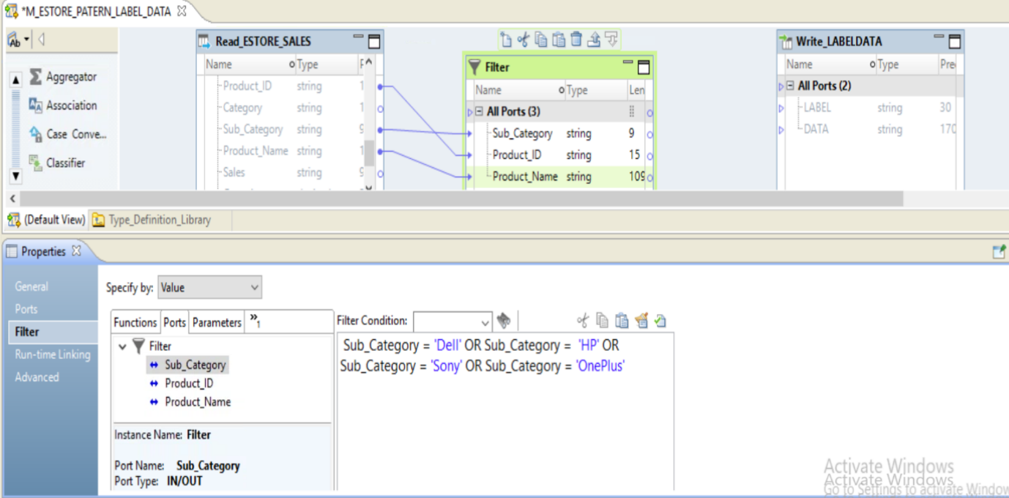
ADD FILTER TRANSFORMATION ➔ FILTER CONDITION ➔ Sub_Category ➔ ‘Dell’ OR ‘HP OR ‘Oneplus’ OR ‘Sony’

Slide 28
Task 4c : ADD expression Transformation and Apply Expression for product

Slide 29
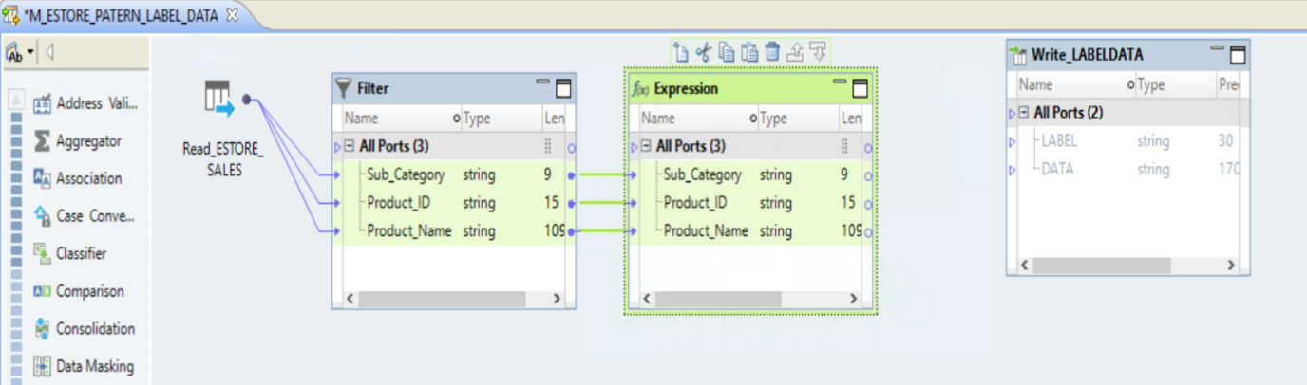
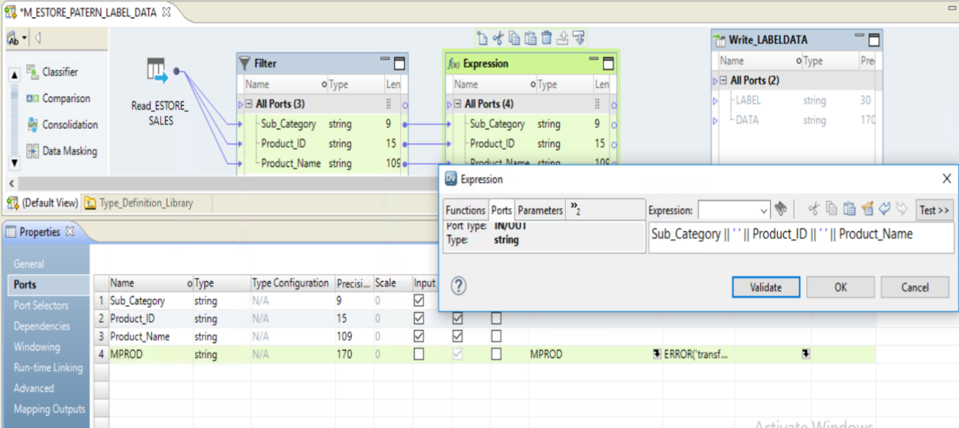
Add EXPRESSION Transformation ➔ drag Sub_Category , Product_id , Product_Name Column into Expression TransformationADD a New Port ➔ MPROD ➔ STRING ➔ 170
MPROD ➔ Sub_Category || ‘ ‘ || Product_ID ||‘ ‘ ||Product_Name

Slide 30
Task 4c : ADD LABELER TRANSFORMATION ➔ Using Tokens with Reference table and Tokenset

Slide 31
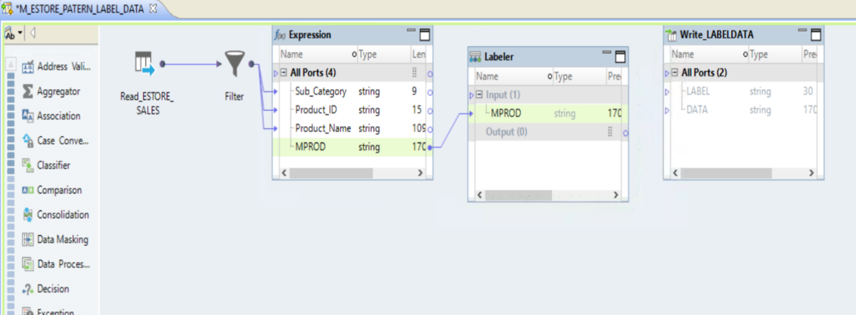
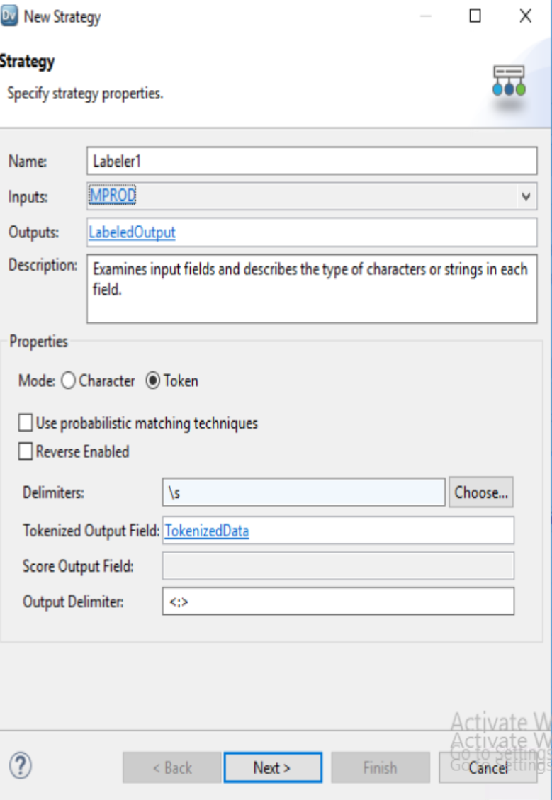
CONFIGURE LABELER ➔ NEW STRATEGY LABELER ➔ PROPERTIES ➔ STRATEGY ➔ NEW STRATEGY
➔ INPUTS ➔ MPROD PROPERTIES ➔ TOKEN Delimeter ➔ \s Output Delimiter ➔ <:> ➔ Click NEXT Button
ADD LABELER TRANSFORMATION
Drag MPROD AS INPUT TO LABELER

Slide 32
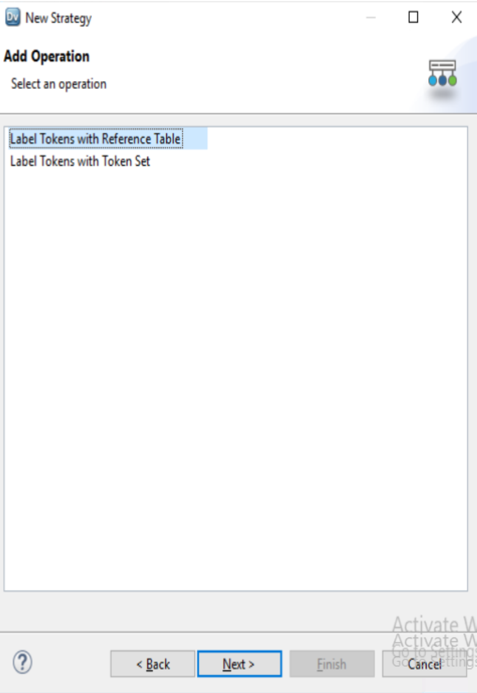
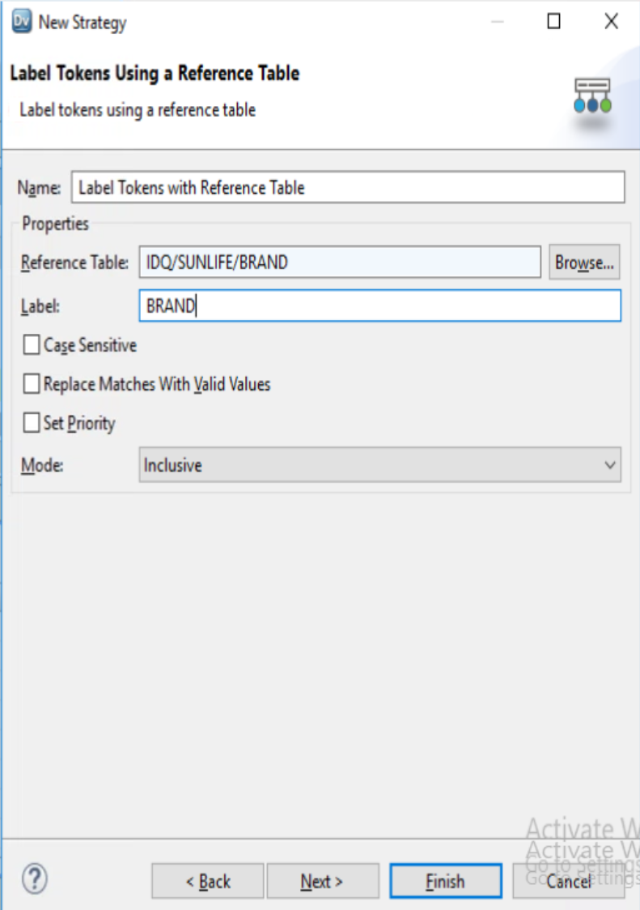
LABEL TOKEN USING REFERENCE TABLE ➔ CHOOSE BRAND Reference table ➔ Label ➔ BRAND ➔ Mode ➔ Inclusive ➔ click Next for Next Label TOKENS

Slide 33
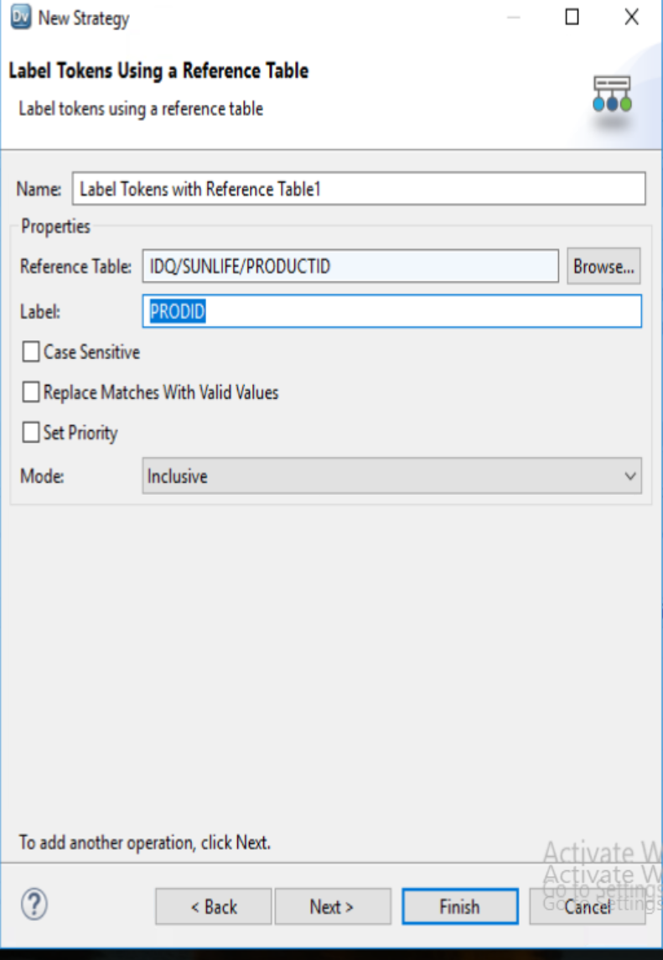
LABEL TOKEN USING REFERENCE TABLE ➔ CHOOSE PRODUCT_ID Reference table ➔ Label ➔ PRODID ➔ Mode ➔ Inclusive ➔ click Next for Next Label TOKENS

Slide 34
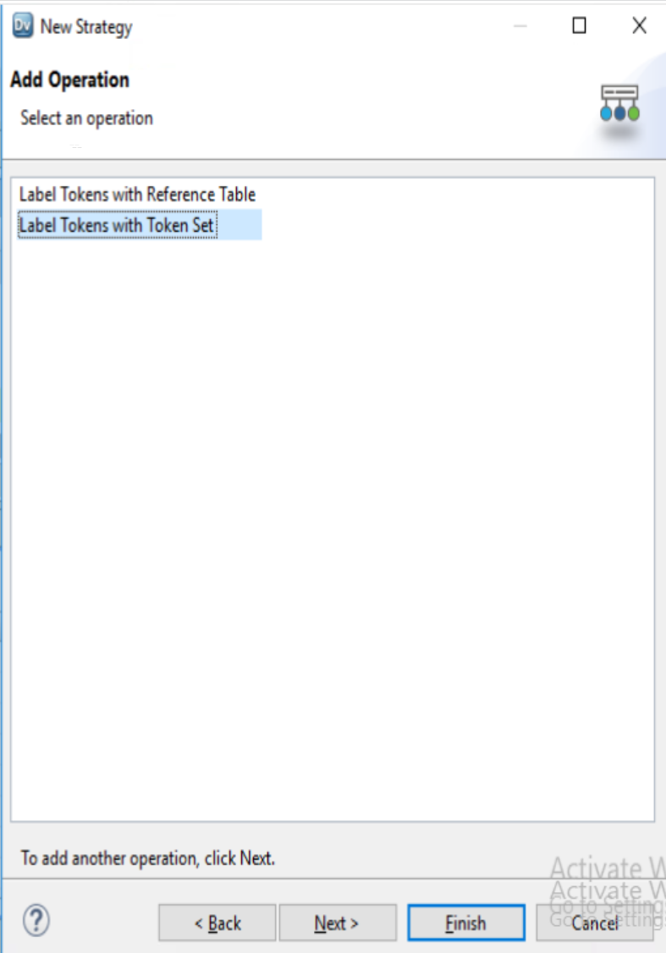
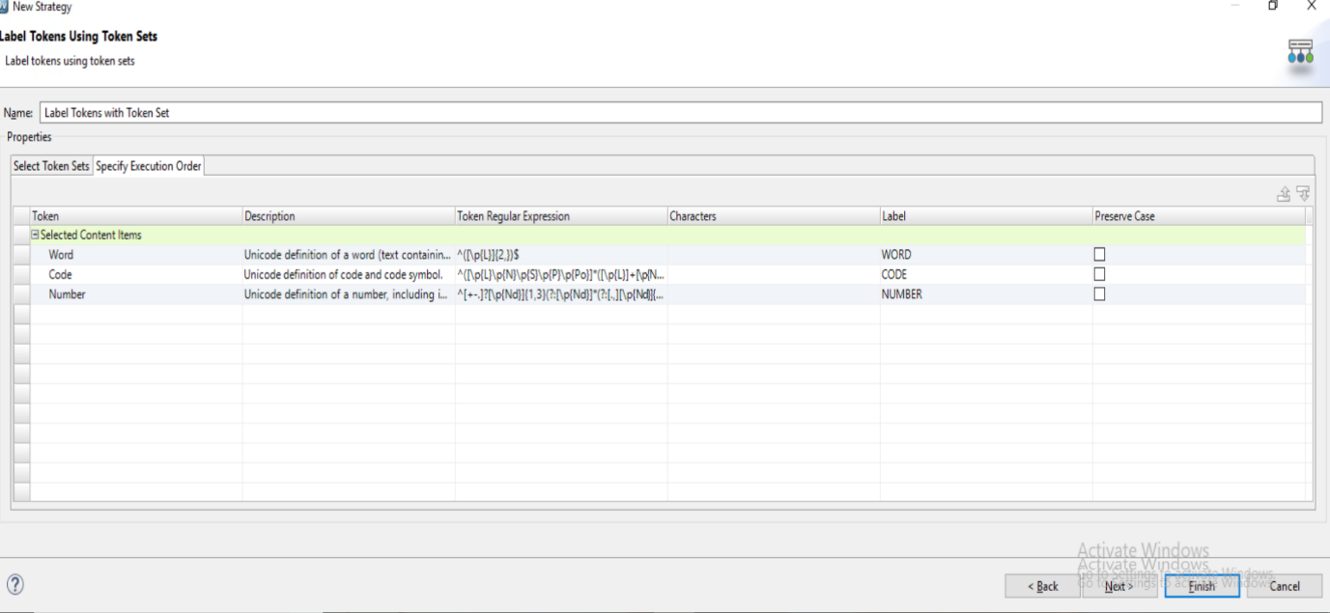
LABEL TOKEN USING TOKEN SETS ➔ WORD ➔ CODE ➔ NUMBER ➔ CLICK ON FINISH

Slide 35
Task 4d : move Columns from Labeler Transformation to Write (LABELDATA)

Slide 36
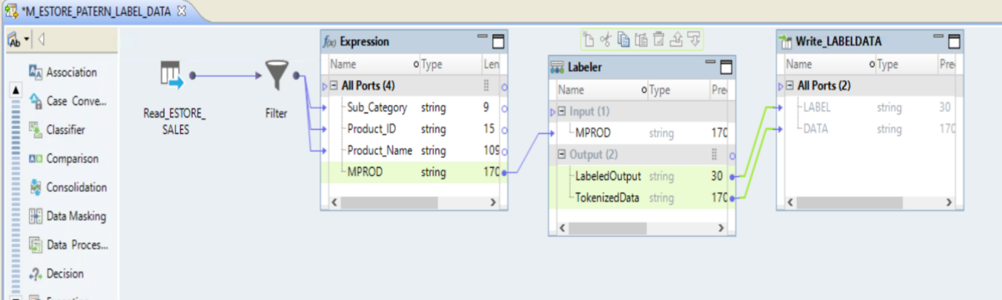
Move Labeler Output columns Labeledoutput and TokenizedData to LABELDATA Target

Slide 37
Task 4E : Save Mapping ➔ Run Data Viewer on Labeler Transformation

Slide 38
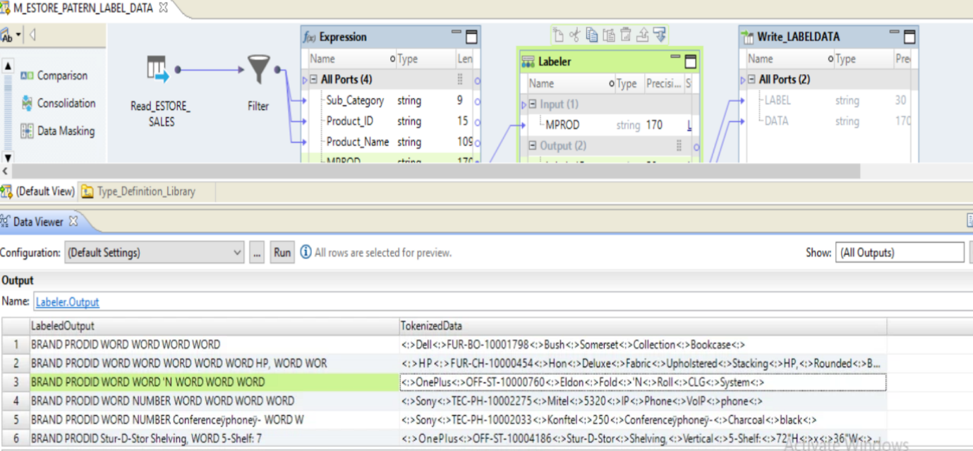
RUN DATA VIEWER ➔ LABELER TRANSFORMATION

Slide 39
Task 4f : Save Mapping ➔ Run Mapping ➔ Produce Product Pattern Label Data

Slide 40
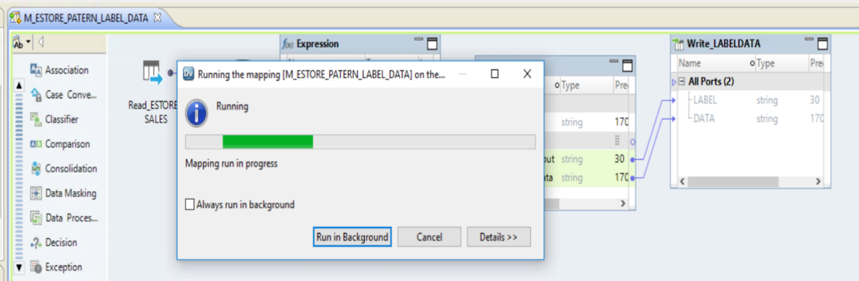
SAVE the Mapping ➔ Run Mapping to Product Product Pattern and TokenDATA

Slide 41
Task 5 : Create Probabilistic Model

Slide 42
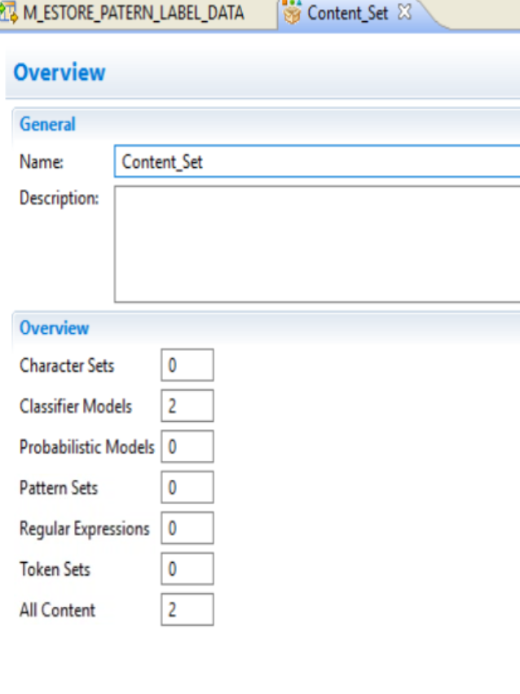
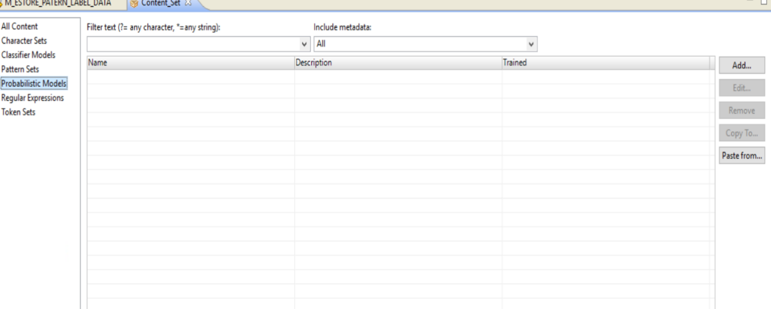
Copy c:\Target\ LABELDATA.txt to C:\data Folder
Open Content Set ➔ Choose Probabilistic Models

Slide 43
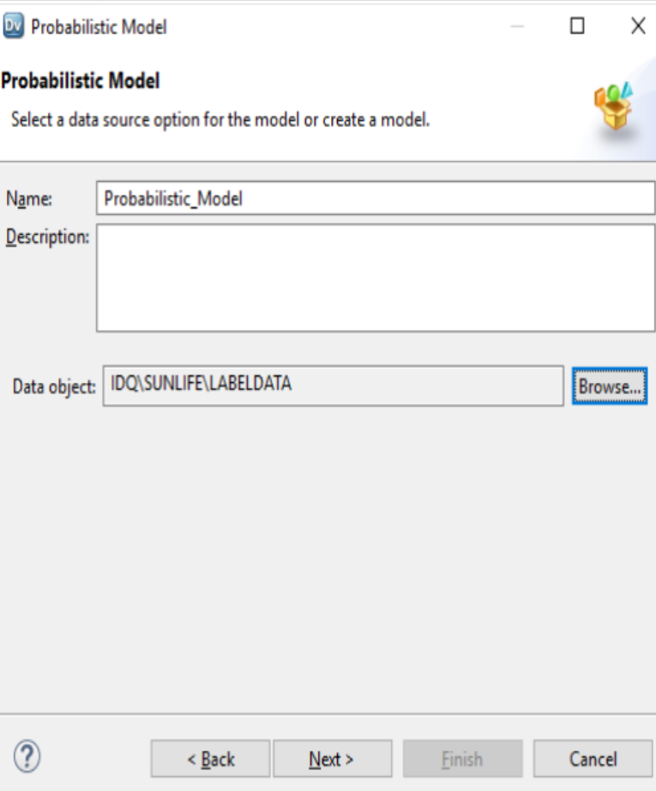
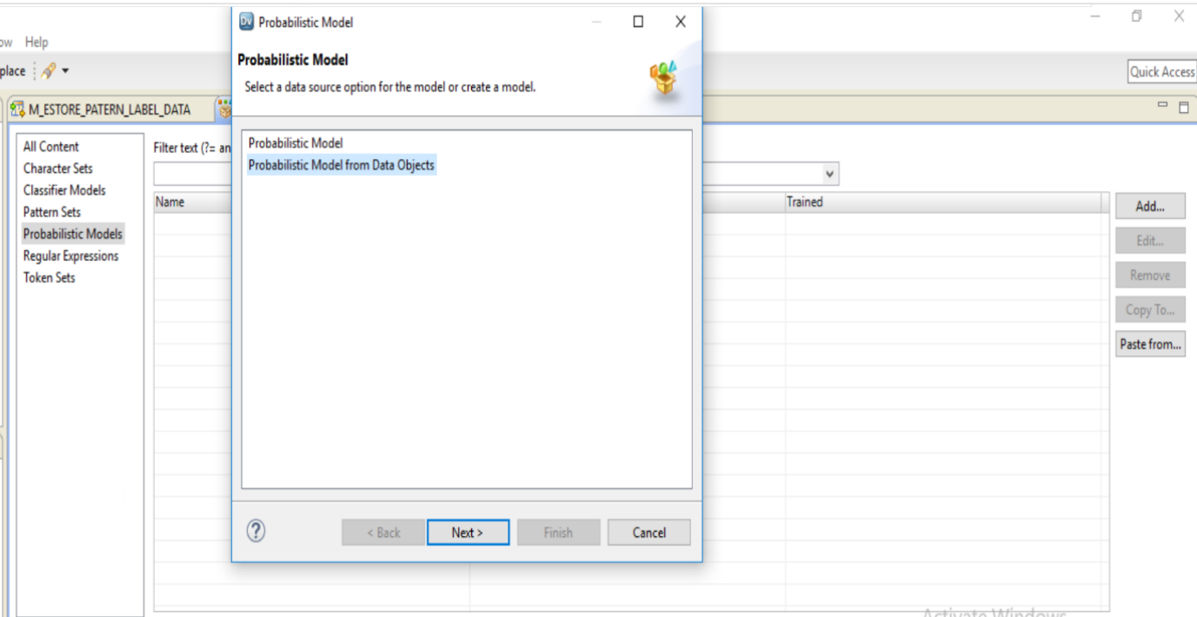
Using Content Set ➔ Add Probabilistic Model from object ➔ Choose LABELDATA

Slide 44
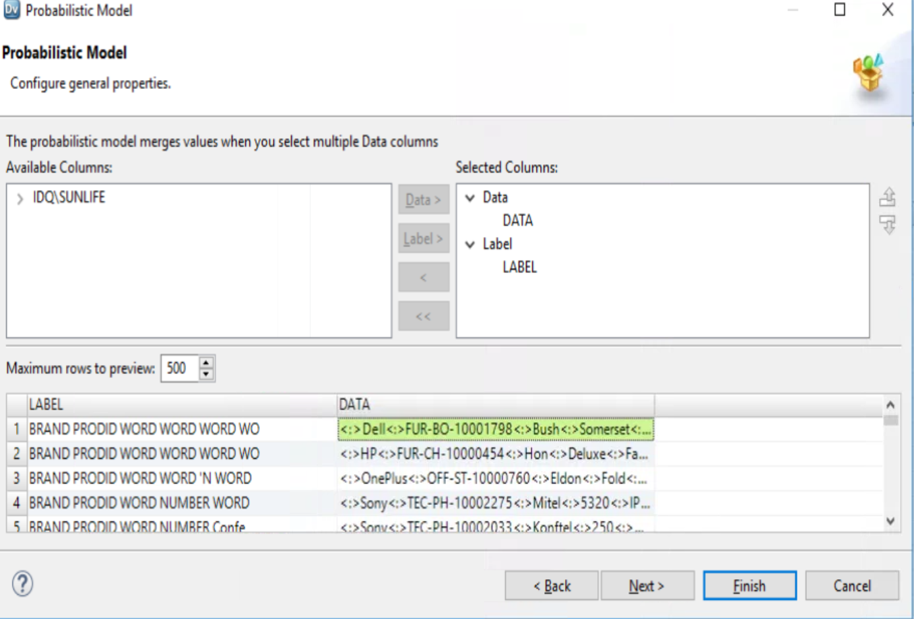
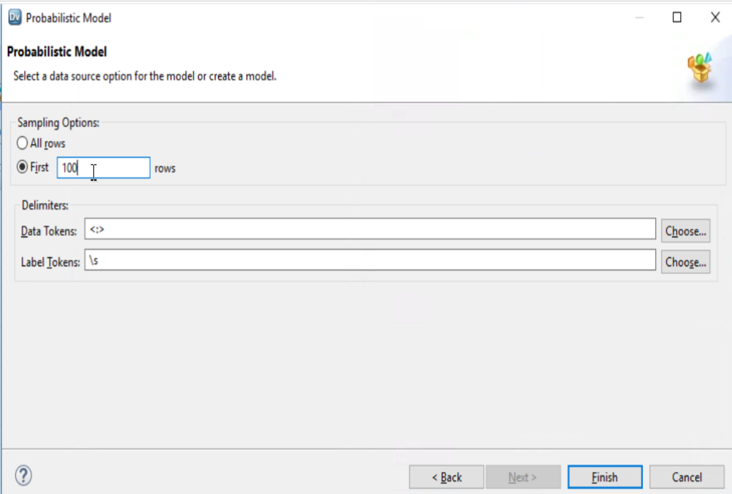
FROM LABEL DATA ➔ MOVE LABEL TO LABEL AND DATA TO DATA IN SELECTED COLUMNS
Select Data Source Option ➔ create Model ➔ Click on Finish Button

Slide 45
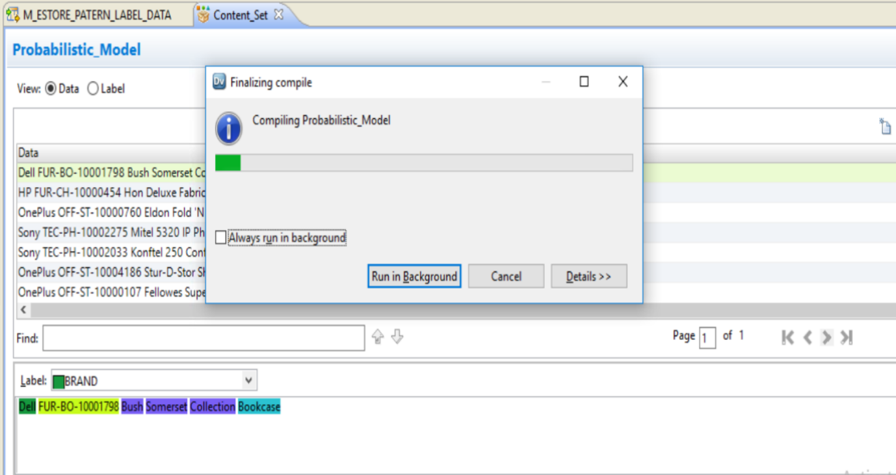
CTRL +S ➔ SAVE THE OBJECT
Compile Probabilistic Train Model

Slide 46
Task 6 : Create Mapping using Advance Parsing Technique ➔ Probabilistic Algorithm

Slide 47
Task 6 a : Create Mapping ➔ Read (estore_sales) + Expression Transformation ➔ Prepare Product Name

Slide 48

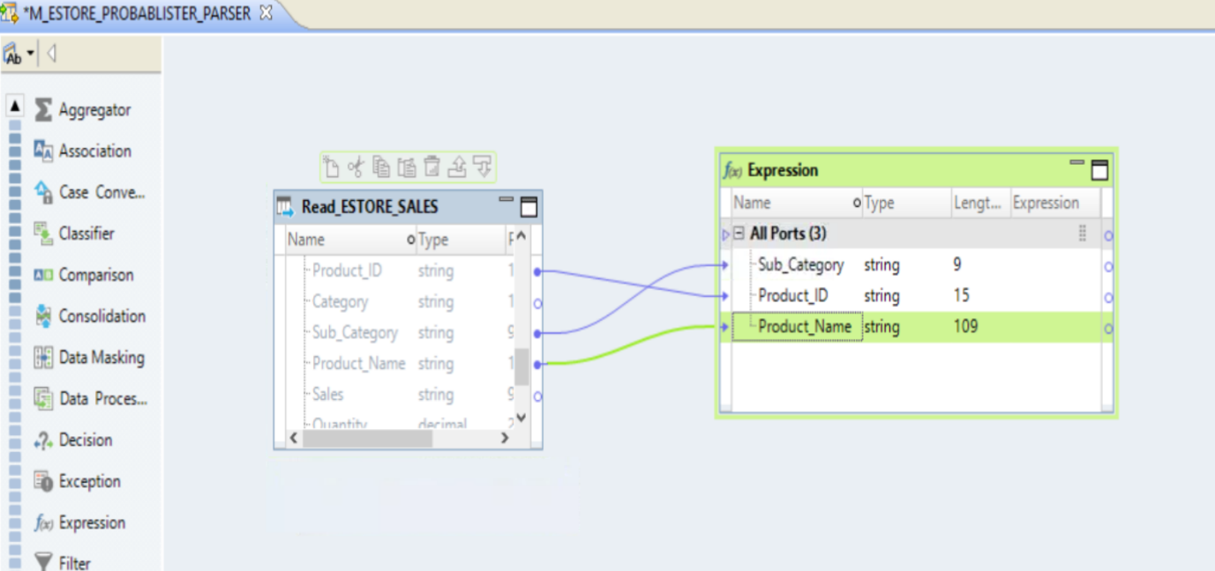
Create New mapiing ➔ Add ESTORE_SALES (Read) + Add Expression Transformation ➔ Drag Sub_category + ProductID + product_Name Column

Slide 49
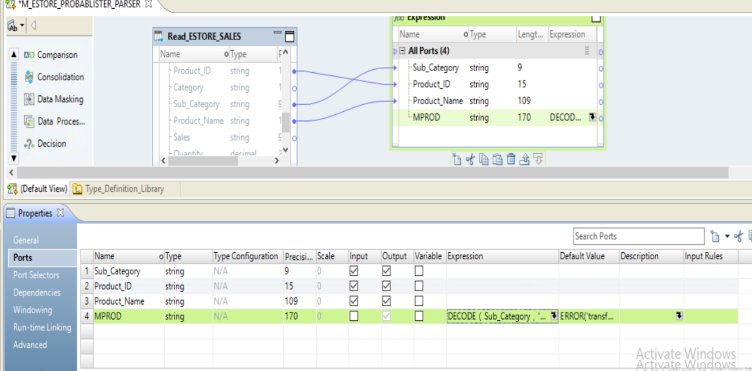
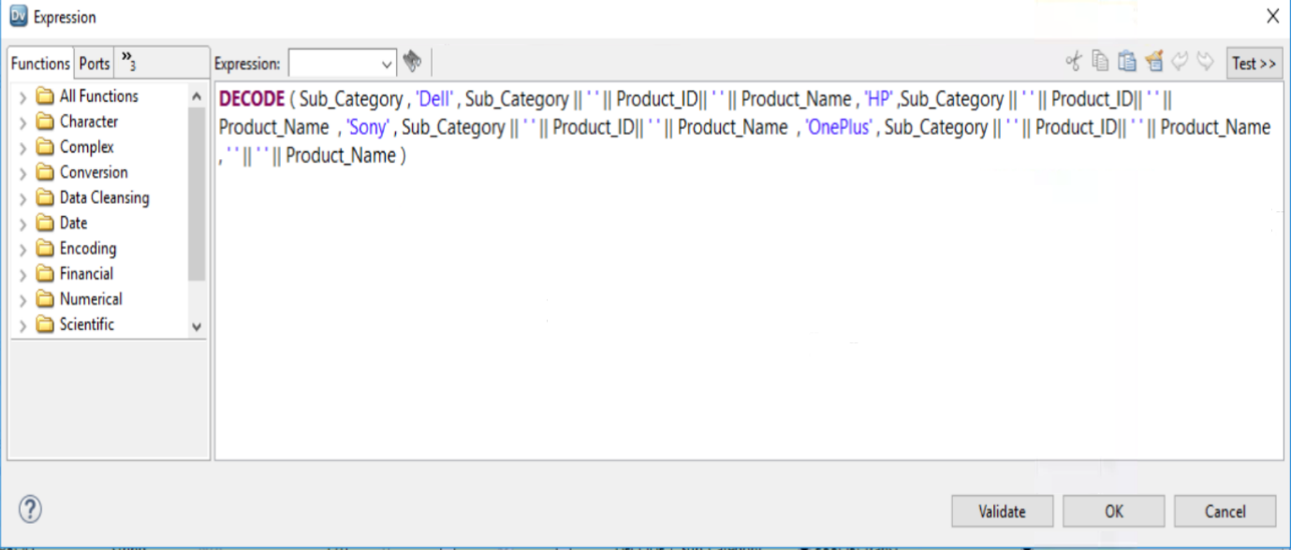
Apply DECODE FUNCTION ➔ Check SUB_CATEGORY ➔ Dell, HP,Sony,OnePlus ➔ Concatenate SUB_CATEGORY + PRODUCTID + PRODUCT NAME with spaces ELSE PASS PRODUCTNAME

Slide 50
Task 6b : ADD Parser Transformation ➔ drag mprod input from Expression To Parser

Slide 51
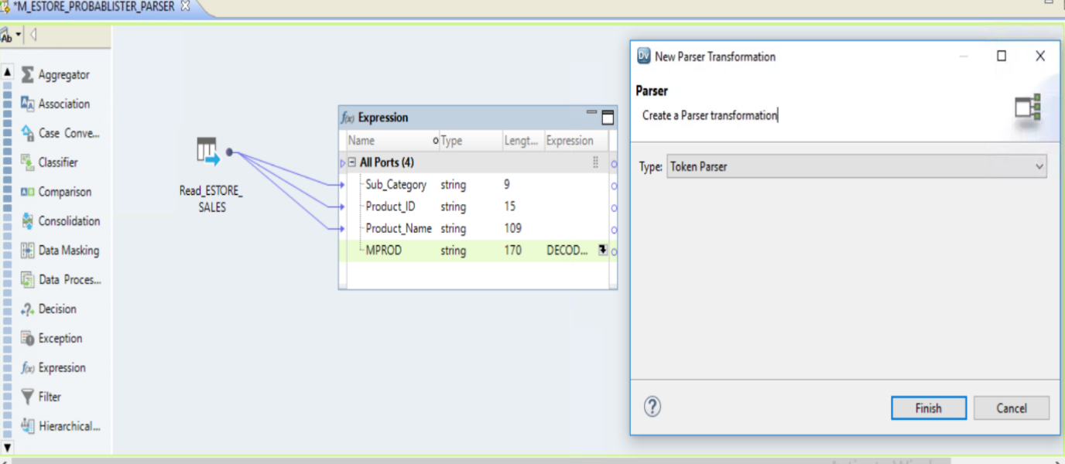
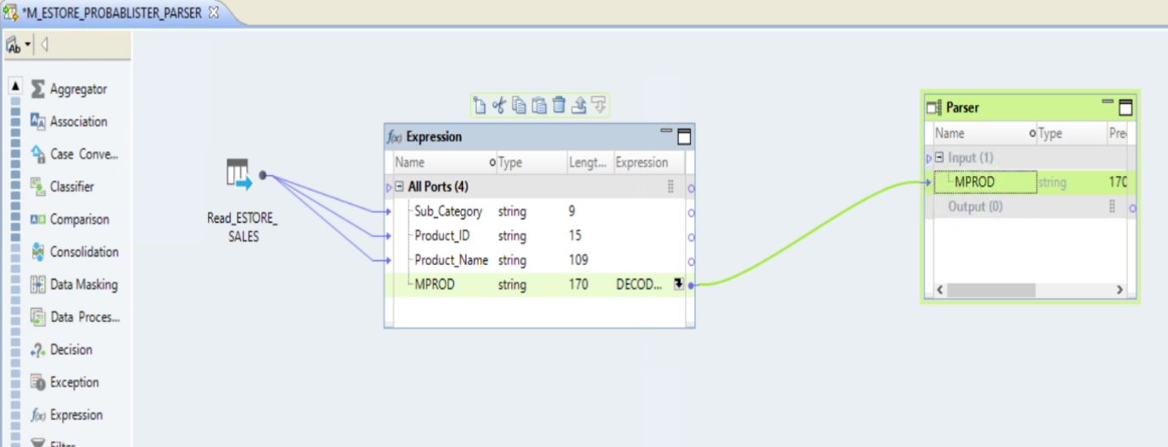
Add PARSER TRANSFORMATION ➔ DRAG MPROD INPUT TO Parser

Slide 52
Task 6c : Configure Parser Transformation ➔ Add Strategies using Probabilistic Matching Algorithms

Slide 53
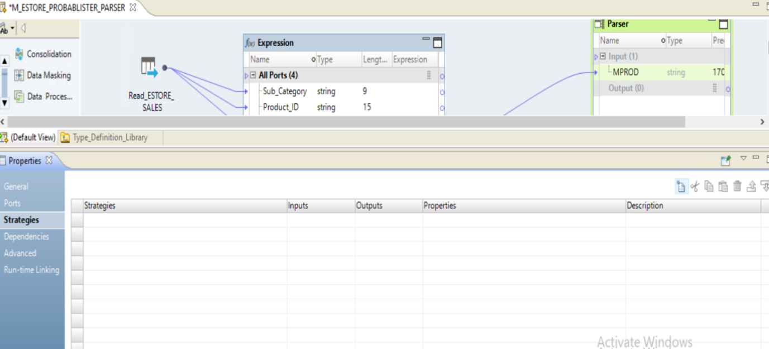
Configure PARSER Transformation ➔ Apply New Strategy

Slide 54
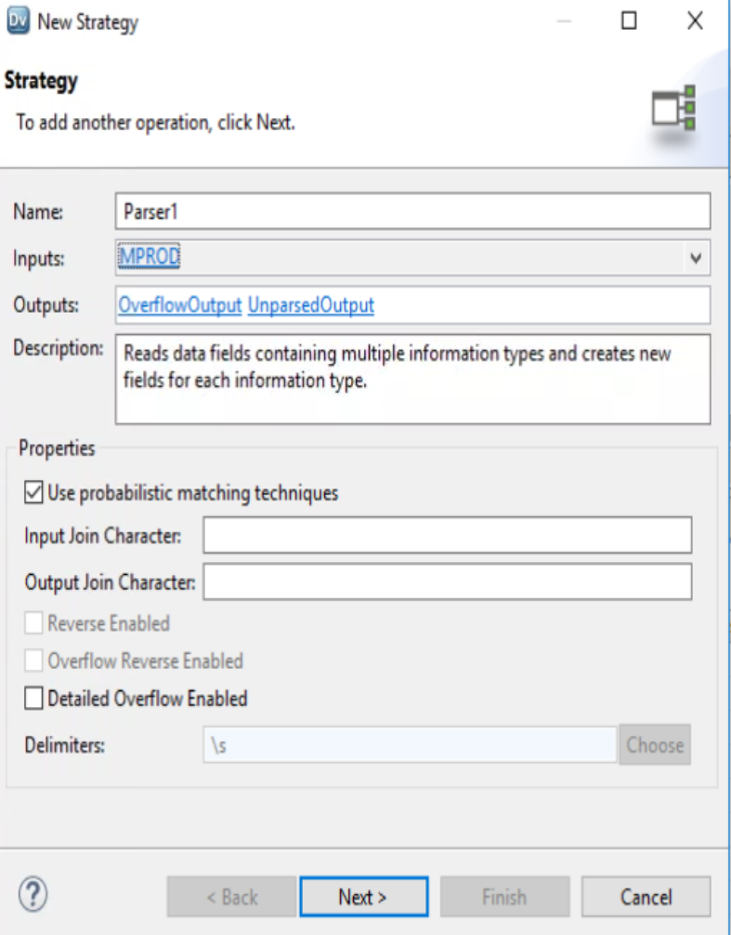


New Strategy ➔ INPUT ➔ MPROD
Use probabilistic Matching Techniques
➔ Click Next
ADD Operation ➔ Parse Token using Probabilistic Models
Choose existing Probabilistic Models which is trained and compiled

Slide 55

After Applying Strategies ➔ PARSER Transformation

Slide 56
Task 6d : Run on Data viewer Parser Transformation to Test Probabilistic Model

Slide 57

Run Data Viewer ➔ PARSER Transformation ➔ Using Probabilistic Model Algorithm ➔ Parse Data

